Slide 1
Introduction to Robotics Course no. 5
Andrei Dumitriu
andrei.dumitriu@fmi.unibuc.ro
Faculty of Mathematics and Computer Science
University of Bucharest

Slide 2
Today’s plan
Robochallenge & co.
Getting started
Homework & Questions
Short recap from last lab
4 digit 7 segment displays
Integrated Circuits: shift register 74HC595

Slide 3
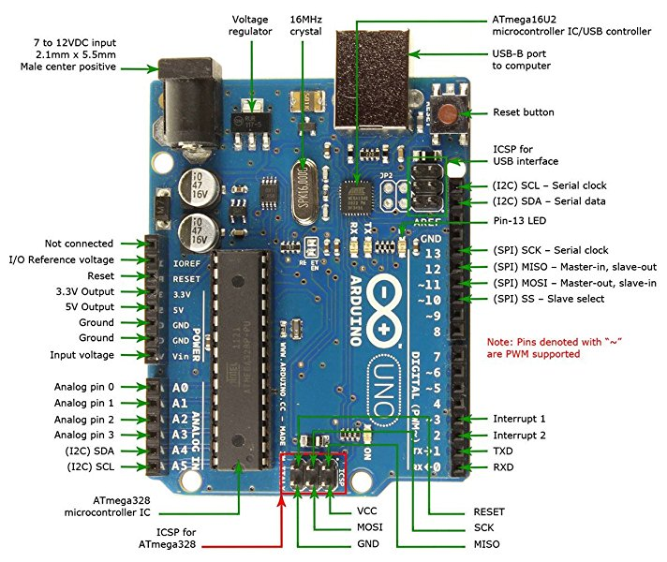
Arduino Uno board

Slide 4
Basic Notations
VCC - Voltage Common Collector = the voltage of the source
GND - Ground = the reference value for the current in the circuit (in our case)
For more details of different types of ground check the following article https://www.autodesk.com/products/eagle/blog/how-does-ground-work-in-electronics/
Ax (e.g. A0) - analogic pin
Dx (e.g.D12) - digital pin

Slide 5
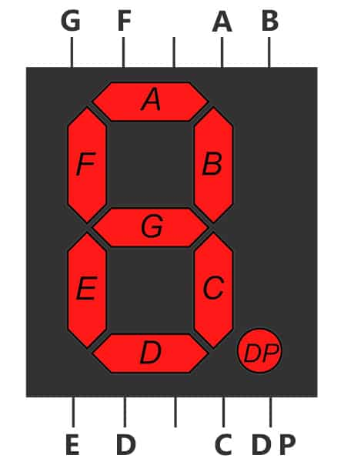
7 segment display
What are they?

Slide 6
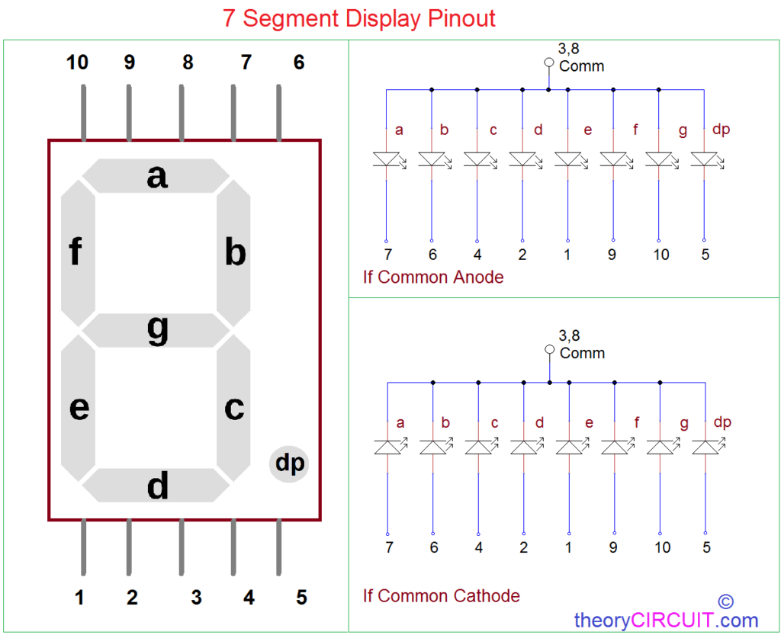
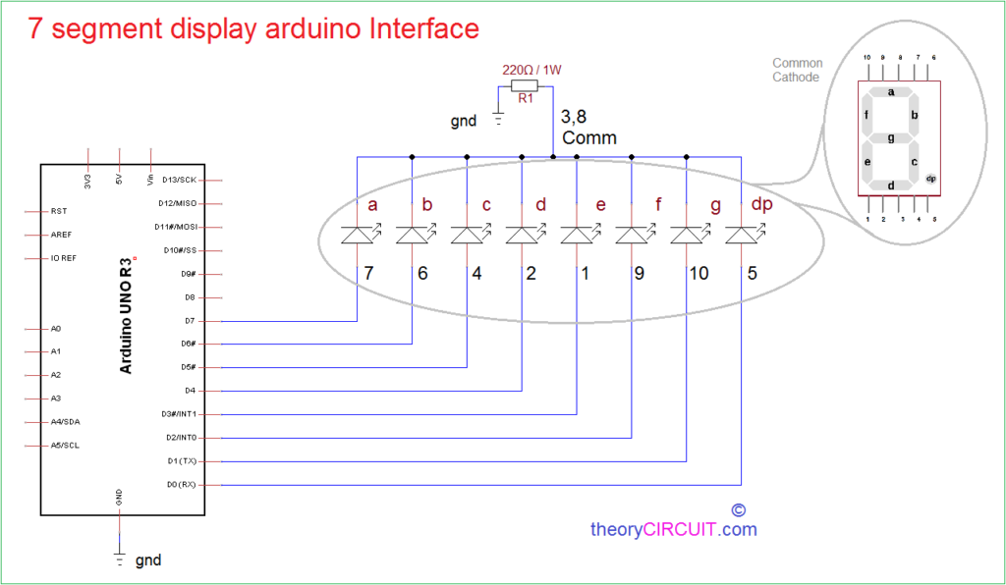
7 Segment display
A bunch of LED’s (how many?) connected in a similar way to the RGB: common anode or common cathode

Slide 7
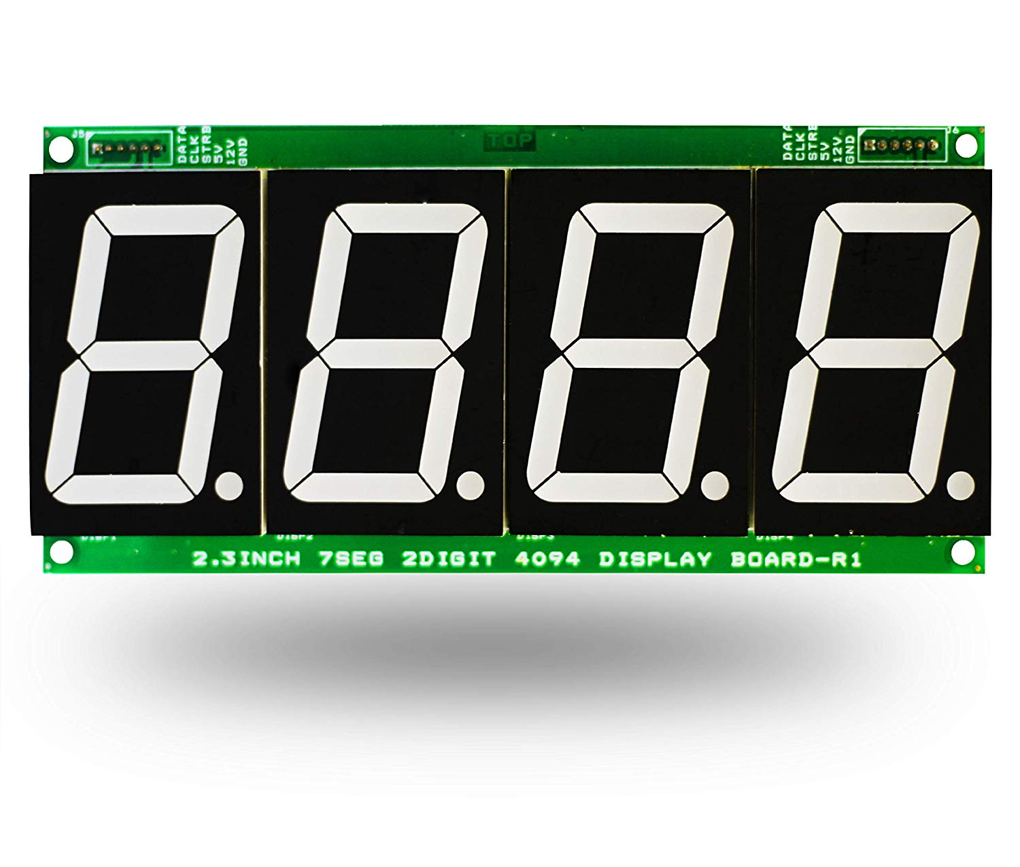
4 digit 7 segment display

Slide 8
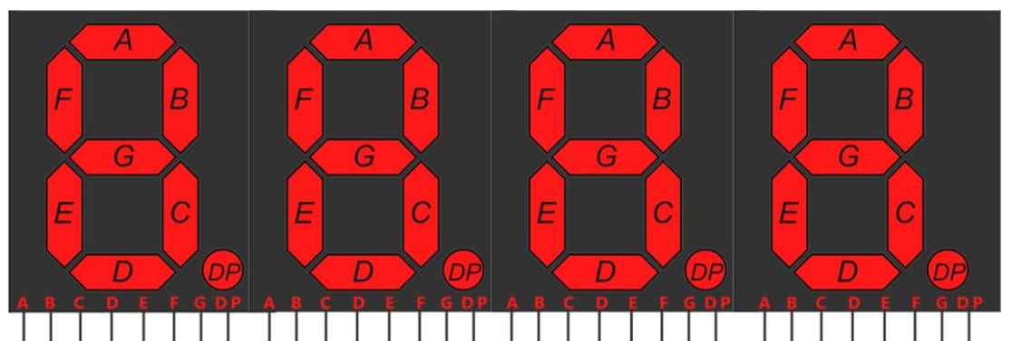
4 digit 7 segment display

Slide 9
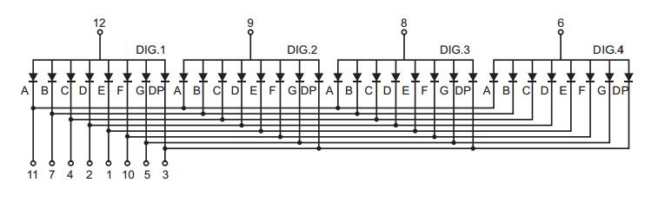
4 digit 7 segment display (Common Anode)

Slide 10
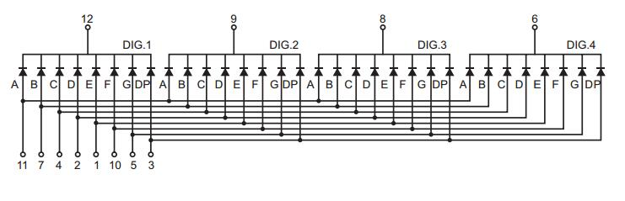
4 digit 7 segment display(Common Cathode)

Slide 11
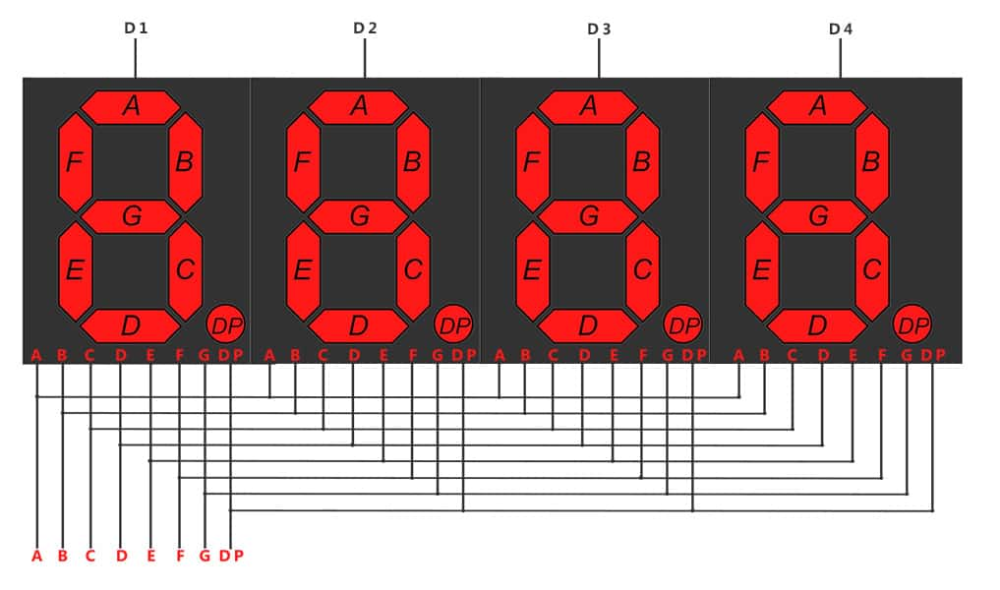
4 digit 7 segment display

Slide 12
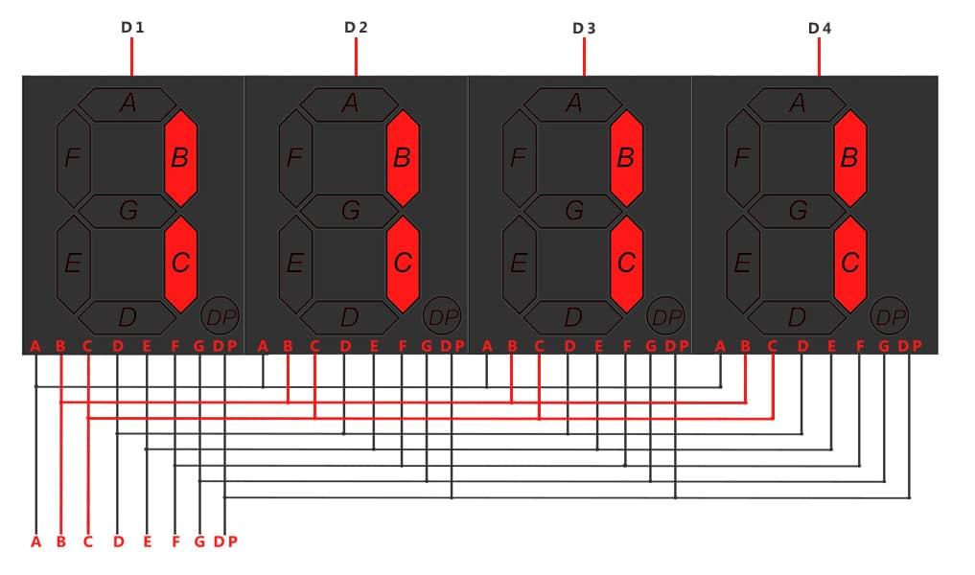
4 digit 7 segment display

Slide 13
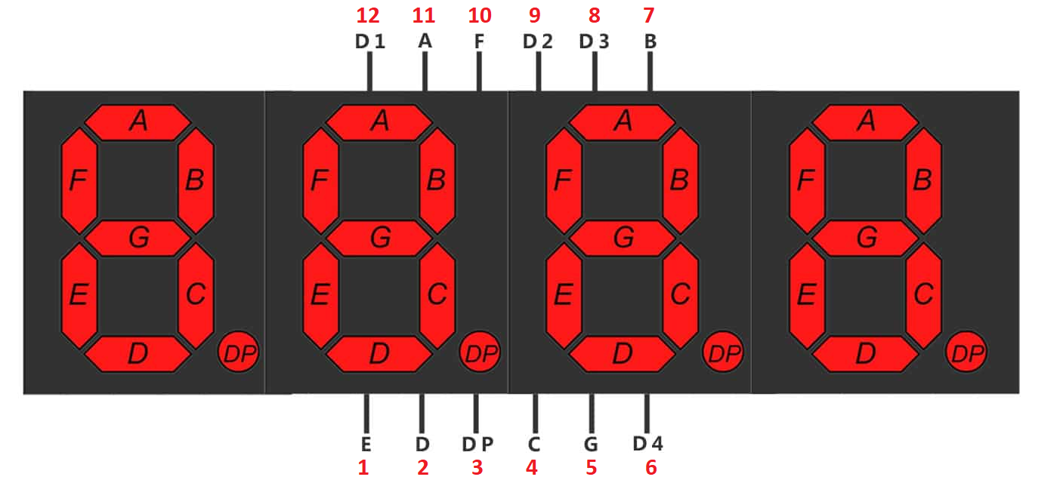
4 digit 7 segment display

Slide 14
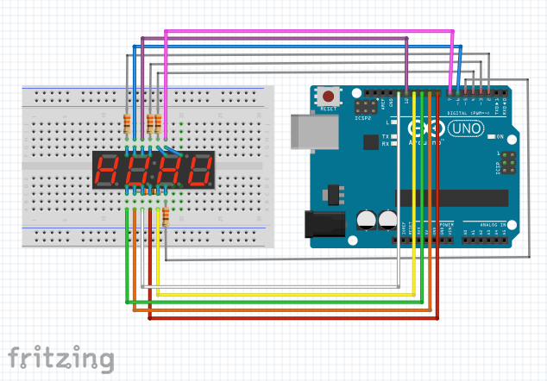
Connections (wrong)

Slide 15
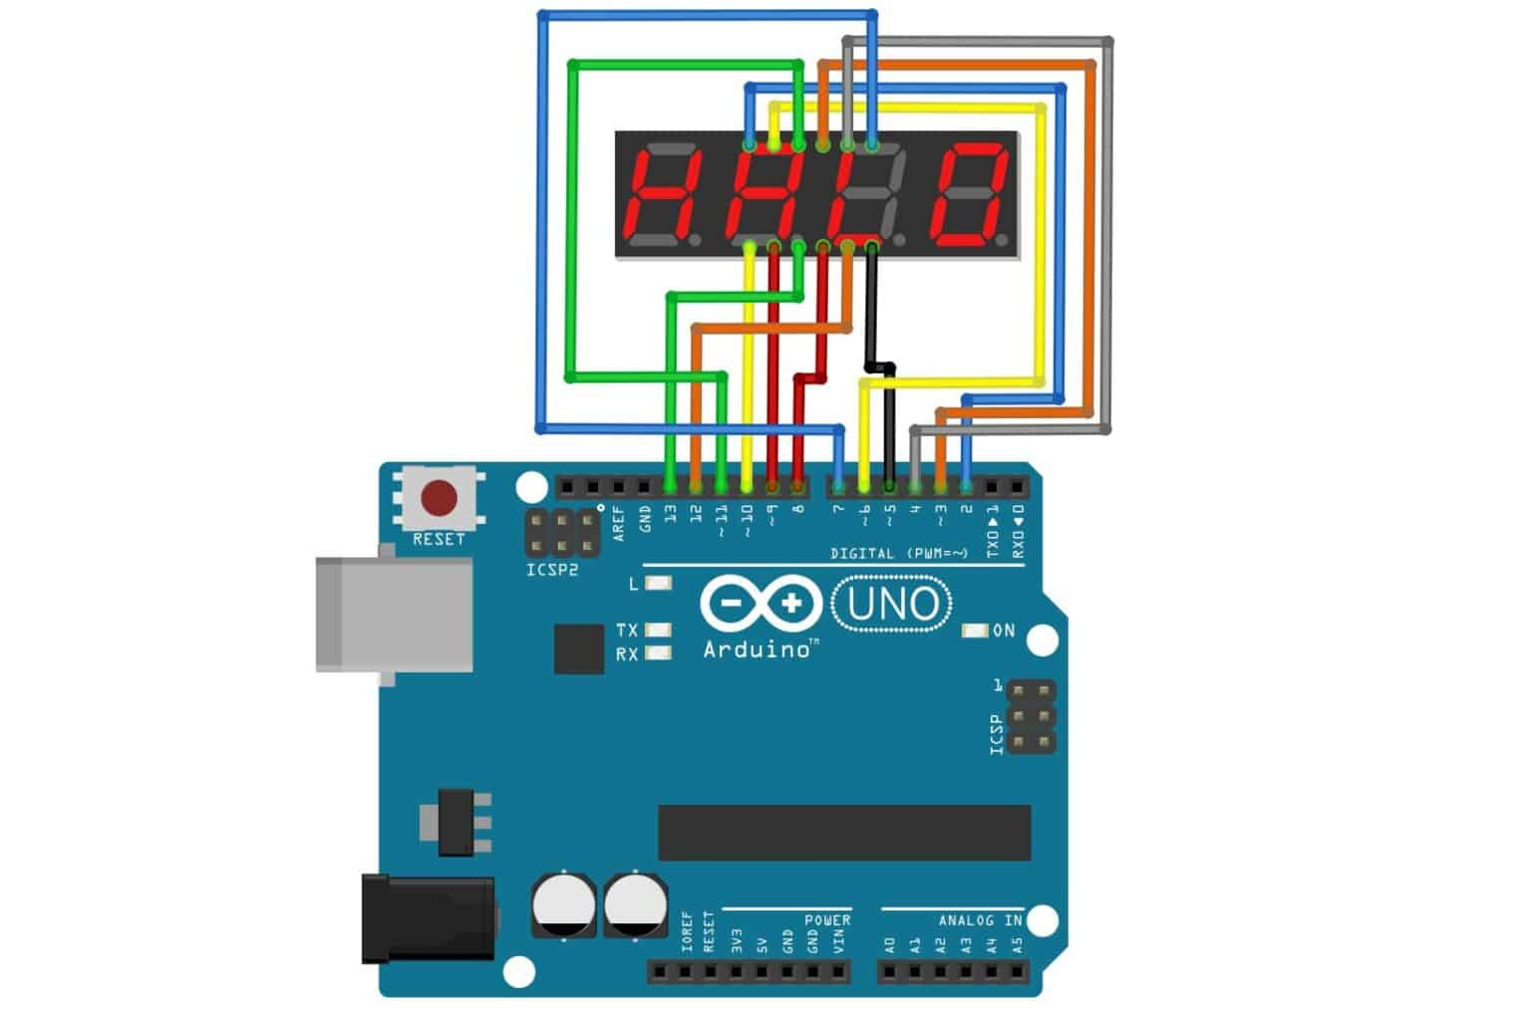
Connections (wrong)

Slide 16
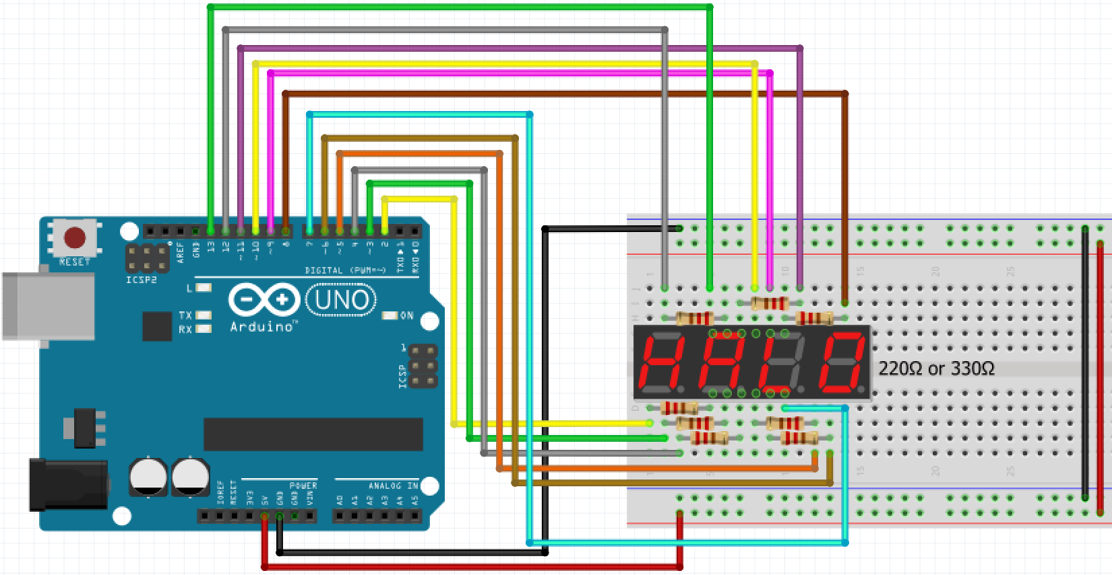
Connections (correct, but not ideal)

Slide 17
How do they work?
Multiplexing (muxing)!
The problem is classic: we have more output need than input
This is present everywhere: your display has millions of pixels, but it is not connected to a million wires
The solution: transmit bits at different times
https://www.youtube.com/watch?v=6piP5YuK0Lc

Slide 18
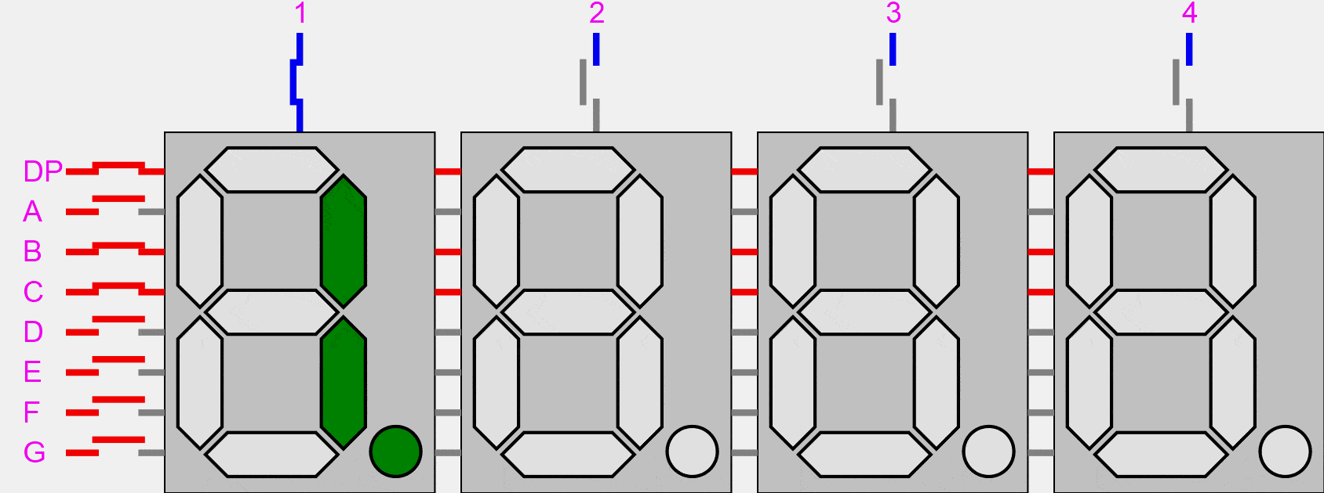
How do they work?

Slide 19
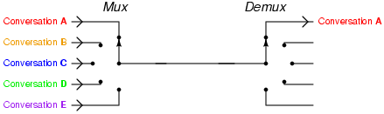
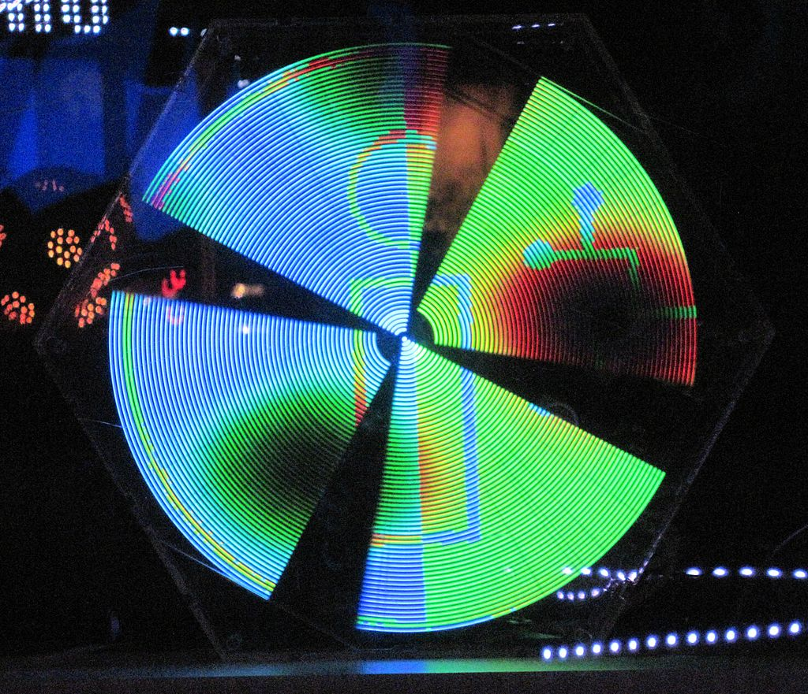
Optical persistence
We take advantage of the fact that our eyes are rather “slow”
If we turn a LED ON and OFF faster than our eyes can “see”, then it will appear to us to be always on, with an averaged light intensity
This is also how we create analog light output values on digital pins
The flicker fusion rate is about 30Hz (emphasys on the about)
FYI: old movies with 24Hz used to repeat each frame 3 times
When we have many lights, we don’t need to turn all of them all at once. Since we have 8 x 4, we can turn each 8 lights at a time.
https://www.youtube.com/watch?v=6piP5YuK0Lc

Slide 20
Optical persistence (some examples)
https://www.youtube.com/watch?v=bcstc1ozczQ
https://www.youtube.com/results?search_query=persistance+of+vision+holographic

Slide 21
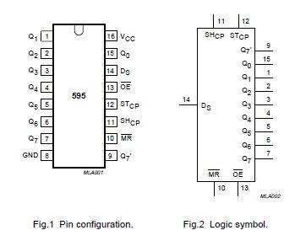
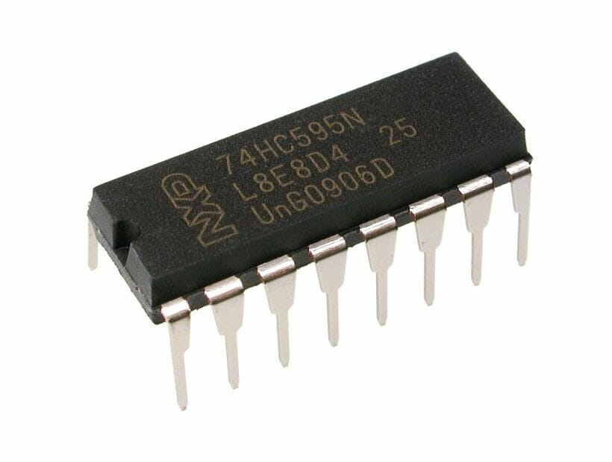
Meet 74HC595
https://www.diodes.com/assets/Datasheets/74HC595.pdf
The datasheet refers to the 74HC595 as an "8-bit serial-in, serial or parallel-out shift register with output latches; 3-state."
What’s that?

Slide 22
Shift registers
It’s a sequential logic circuit
Used for storage or transfer of binary data
Can convert from serial to parallel data
Can be used for data communications
Used as memory or buffer stages within other chips
For our use case, they allow us to use less pins in an Arduino
We’ll be calling it simply a shift register

Slide 23
Shift Registers
There are 4 types of shift registers:
SIPO -> Serial In Parallel Out
PISO -> Parallel In Serial Out
PIPO -> Parallel In Parallel Out
SISO -> Serial In Serial Out

Slide 24
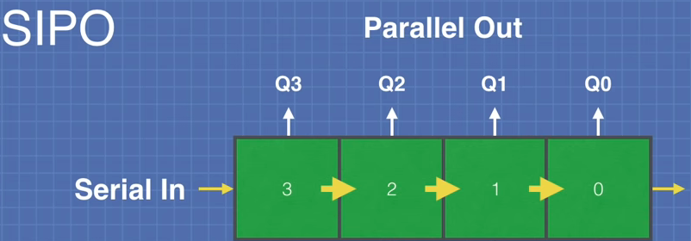
Shift Registers
There are 4 types of shift registers:
SIPO -> Serial In Parallel Out

Slide 25
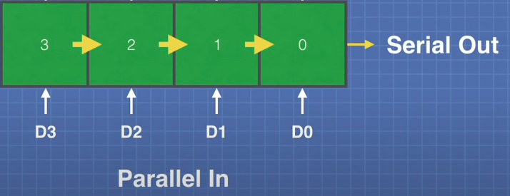
Shift Registers
There are 4 types of shift registers:
SIPO -> Serial In Parallel Out
PISO -> Parallel In Serial Out

Slide 26
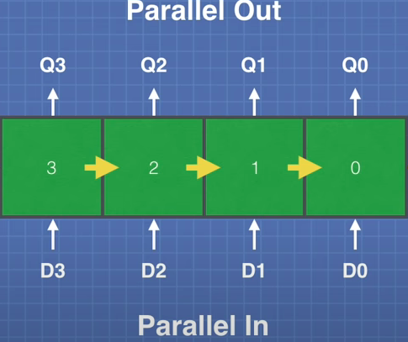
Shift Registers
There are 4 types of shift registers:
SIPO -> Serial In Parallel Out
PISO -> Parallel In Serial Out
PIPO -> Parallel In Parallel Out

Slide 27
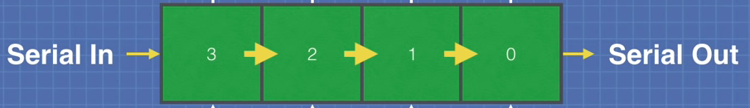
Shift Registers
There are 4 types of shift registers:
SIPO -> Serial In Parallel Out
PISO -> Parallel In Serial Out
PIPO -> Parallel In Parallel Out
SISO -> Serial In Serial Out

Slide 28
Shift Registers
There are 4 types of shift registers:
SIPO -> Serial In Parallel Out
PISO -> Parallel In Serial Out
PIPO -> Parallel In Parallel Out
SISO -> Serial In Serial Out
While an easier case can be made for SIPO and PISO (which one is it, tho’?), PIPO and SISO can seem quite useless. What are their use cases?

Slide 29
Shift Registers
Most popular
SIPO, which can expand the number of a microcontroller outputs
PISO, which can expand the number of a microcontroller inputs
PIPO and SISO are used for data storage and data buffering

Slide 30
Shift Registers
Most popular
Arduino can use the SPI library and the SPI pins for control
But can also use any other pins (which we will most likely do)

Slide 31
Back to 74HC595
8-stage serial shift register
3 state output:
HIGH
LOW
high-impedance state (effectively disconnecting it from the circuit)
data is placed in a storage register. This is what appears on the output
serial input and output for cascading

Slide 32
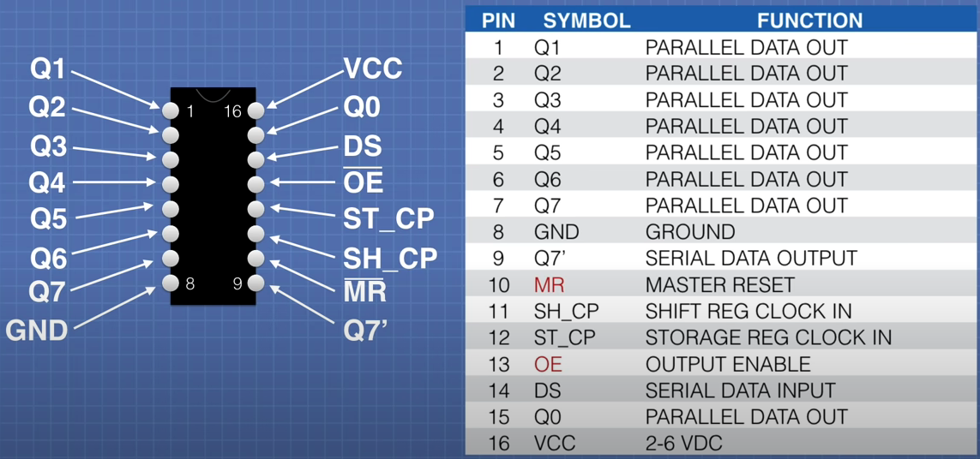
Back to 74HC595

Slide 33
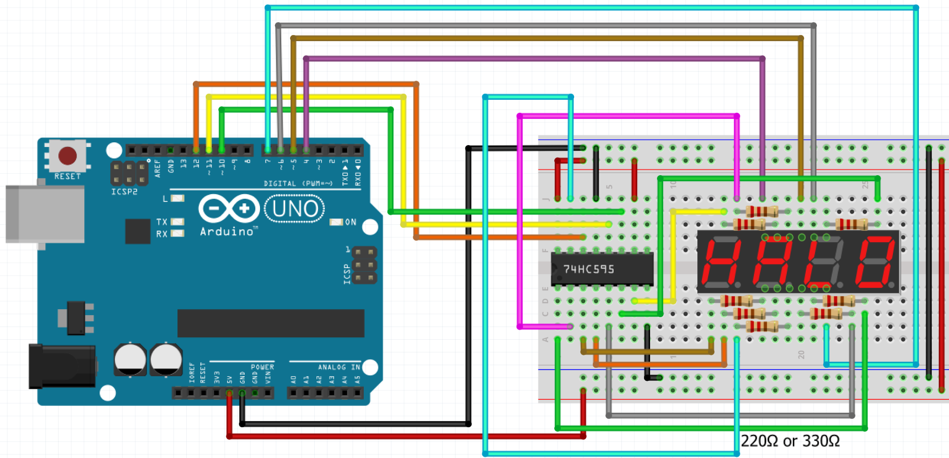
How does it work?

Slide 34
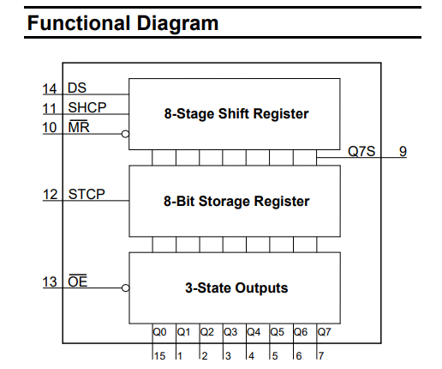
How does it work?

Slide 35
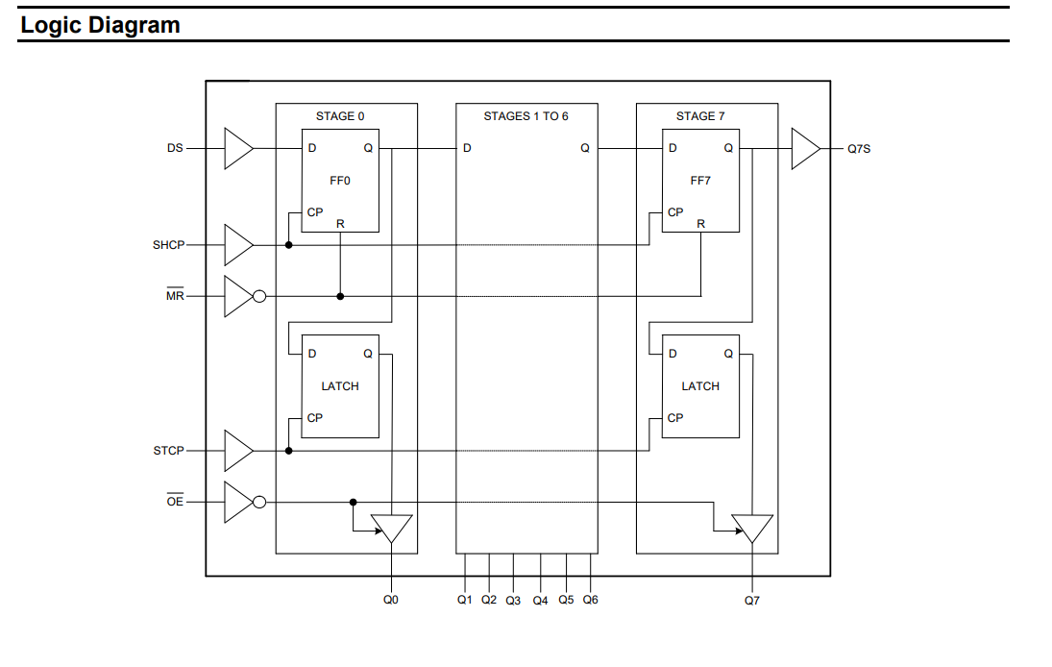
How does it work?

Slide 36
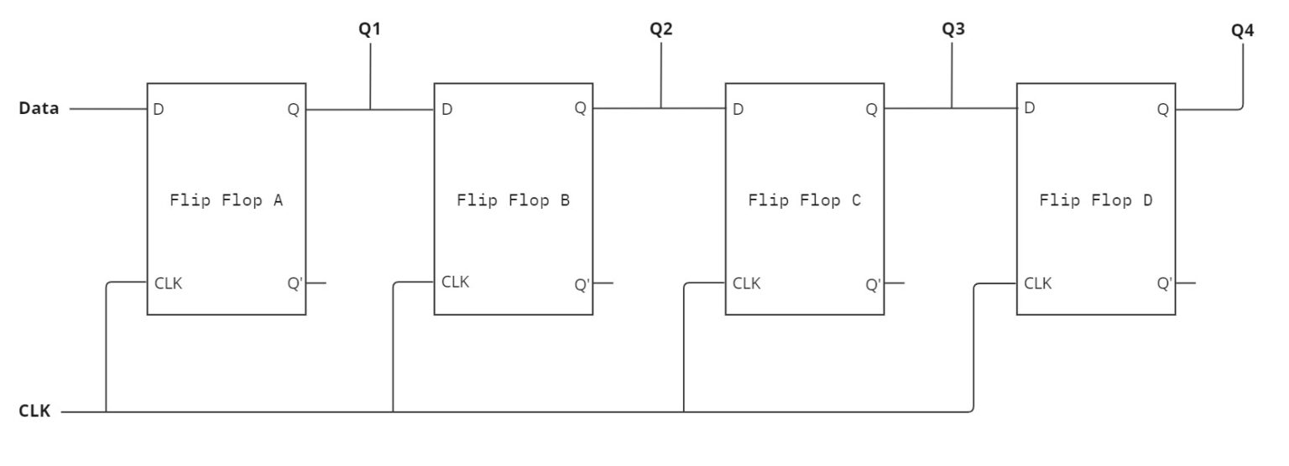
How does it work?

Slide 37
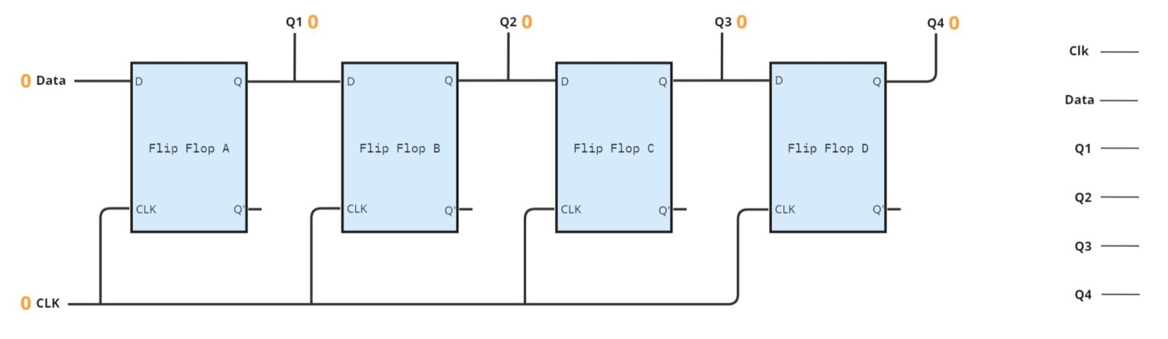
How does it work?
First, the shift register has no inputs set.

Slide 38
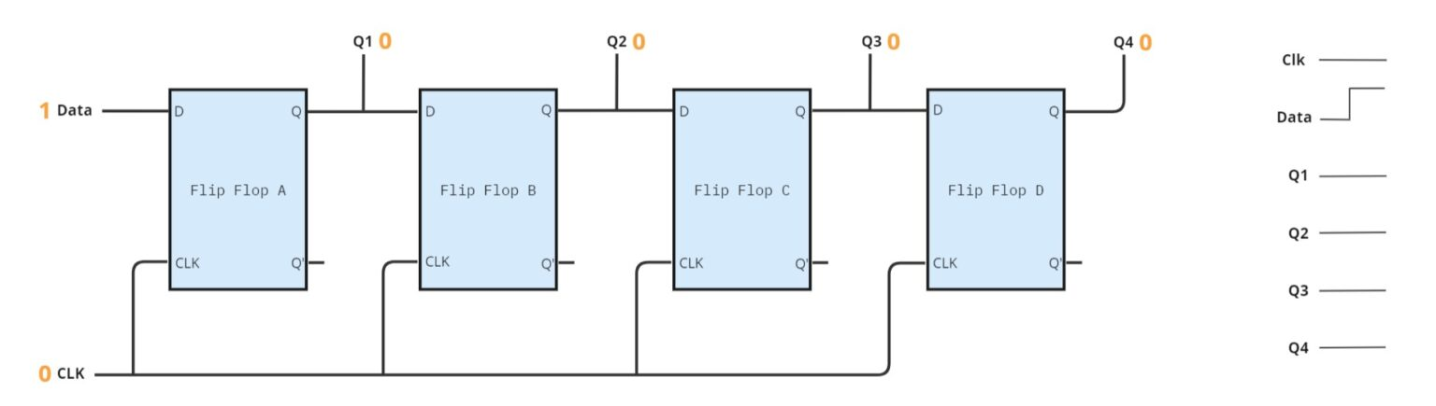
How does it work?
Then, we set the Data to 1. However, since the clock is still at 0, no data will be transferred into the shift register.

Slide 39
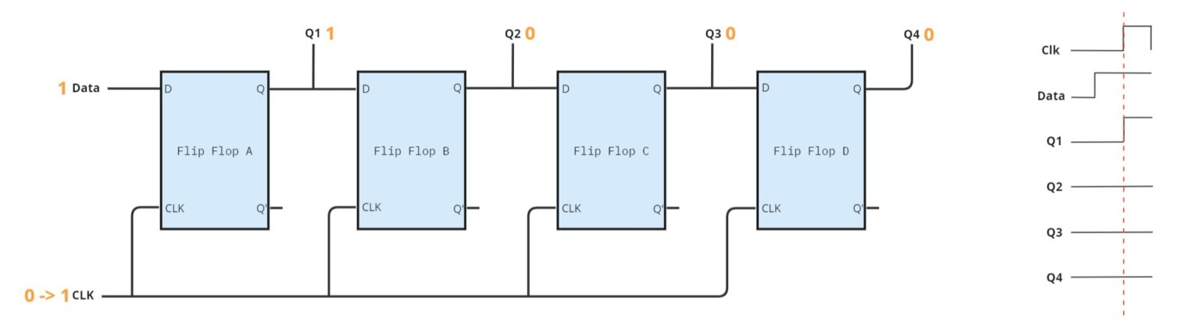
How does it work?
When the Clock is set to 1, each flip flop stores the data signal and outputs it to the Q output. Flip-flops are edge triggered, meaning they transfer data to the output Q only when the clock changes from 0 to 1.

Slide 40
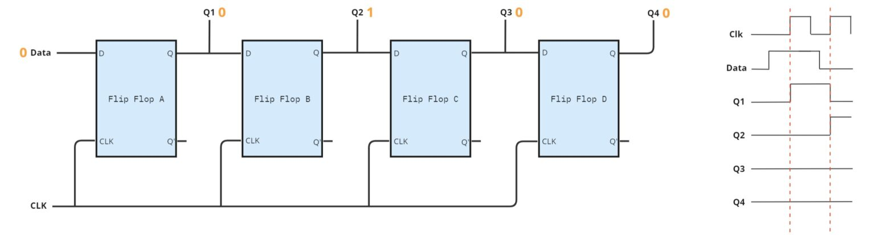
How does it work?
Next, we set the data to 0, and then trigger the clock again. The Q1 Output will receive the new value of the Data, which is 0, but the Flip Flop B will transfer the 1 from the output of the first Flip Flop to its output.

Slide 41
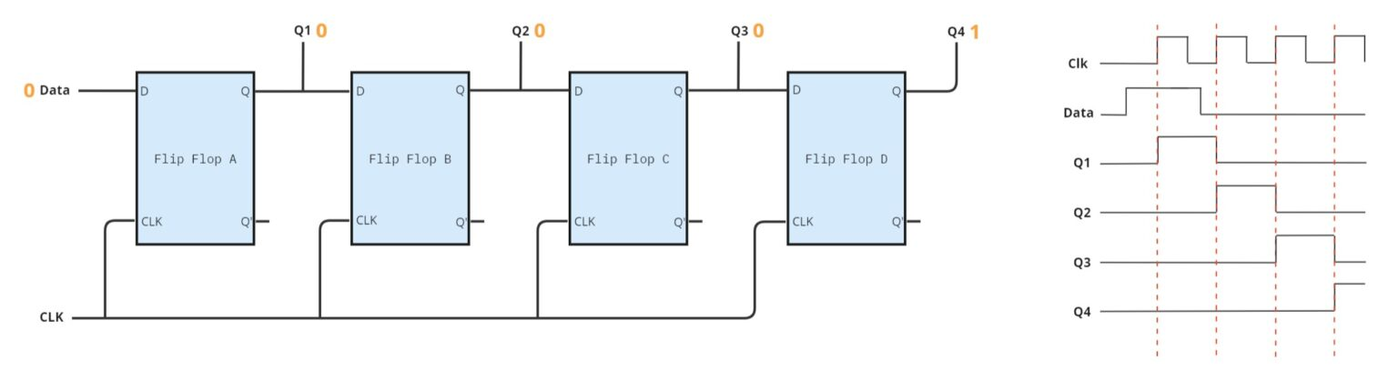
How does it work?
In the next clock trigger, the Flip Flop B will transfer the 0 from its input to the Q2 output, while the Flip Flop C will get the 1 from its input and will transfer to its output Q3. The shifting pattern begins to emerge.

Slide 42
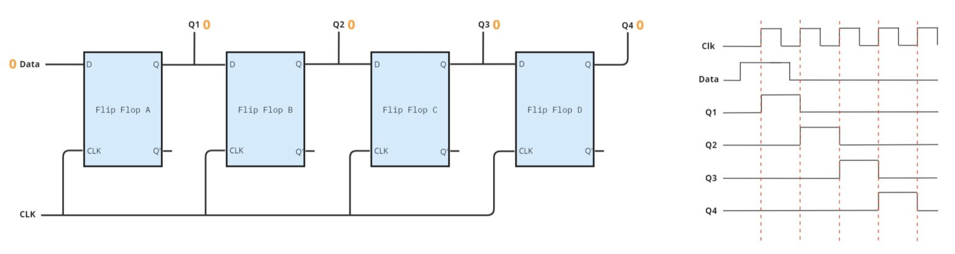
How does it work?
Finally, in the next clock edge, the Q4 will be set to 0, completing the shifting of the one bit that initially started as input.

Slide 43
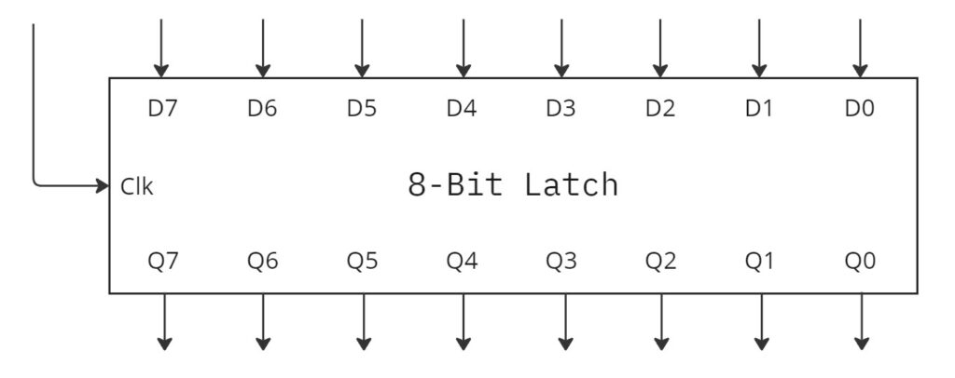
How does it work?
A latch is a digital component that stores a bit for future use. When the clock is set to 1, the previously set input value is transferred to the output.

Slide 44
Back to 74HC595

Slide 45
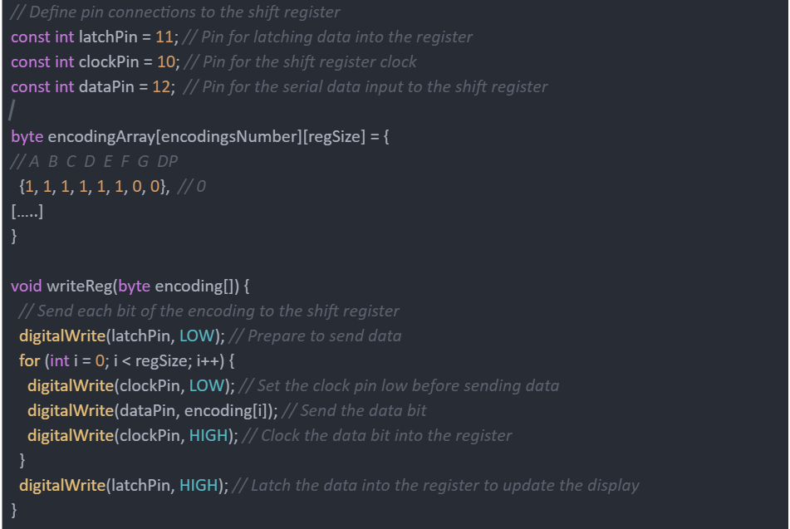
Back to 74HC595

Slide 46
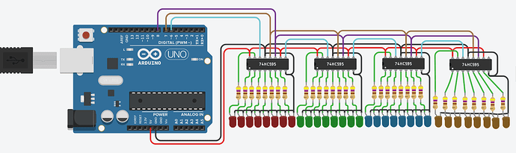
Daisy chaining

Slide 47
Daisy chaining
How do PISO work, though?

Slide 48
Links
Persistence of vision: https://en.wikipedia.org/wiki/Persistence_of_vision
Multiplexing: https://en.wikipedia.org/wiki/Multiplexing
Shift register on arduino.cc (with daisy chain): https://www.arduino.cc/en/Tutorial/Foundations/ShiftOut
Shiftout function: https://www.arduino.cc/reference/en/language/functions/advanced-io/shiftout/
Good explanation of shift register on youtube (highly recommended): https://www.youtube.com/watch?v=Ys2fu4NINrA
Datasheet on 74HC595: https://www.diodes.com/assets/Datasheets/74HC595.pdf
https://www.youtube.com/watch?v=fYAlE1u5rno

